Slide 1
F# MVC for WPF
Dmitry Morozov
April 23, 2013

Slide 2
WHY | WHAT
Try F# with WPF | F# is great general purpose language
Deliver something generic and reusable | F# MVC for WPF framework http://github.com/dmitry-a-morozov/fsharp-wpf-mvc-series
Share with community | Learning series http://github.com/dmitry-a-morozov/fsharp-wpf-mvc-series/wiki

Slide 3
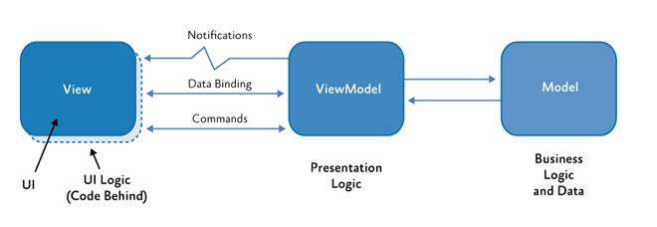
MVvm (Model-View-ViewModel)

Slide 4
Can we do better in F#?
MVVM has many shortcomings
It’s still hard to develop WPF apps using MVVM
MVVM was designed with C# limitations in mind

Slide 5
FIRST class EventS-Driven architecture
type View = IEvent<Events>
and Events =
| Add of int
| Subtract of int
type Model = { State : int }
type Controller = Events -> Model -> Model
type Mvc = Controller -> Model -> IEvent<Events> -> Model

Slide 6
model
Not domain model
Based on Castle Dynamic Proxy
Raises INPC.PropertyChanged from setter interceptor
Restrictions: virtual properties + base class + factory method +parameterless ctor
DECLARATIVE, FUNCTIONAL STYLE
Type definition only, no imperative logic
It is better to have 100 functions operate on one data structure than 10 functions on 10 data structures.

Slide 7
VIEW
type IView<'Events> =
inherit IObservable<'Events>
abstract SetBindings : obj -> unit
Event source
Data binding target (model is the DataContext)
Both parametric (‘Events) and subtype (interface) polymorphism
F# support for .NET events makes experience really smooth
DU is better than Enum (pattern matching, extra state)

Slide 8
Model – subset of view state
View
Model
Data binding

Slide 9
Controller
type IController<'Events, 'Model> =
abstract InitModel : 'Model -> unit
abstract EventHandler : ('Events -> 'Model -> unit)

Slide 10
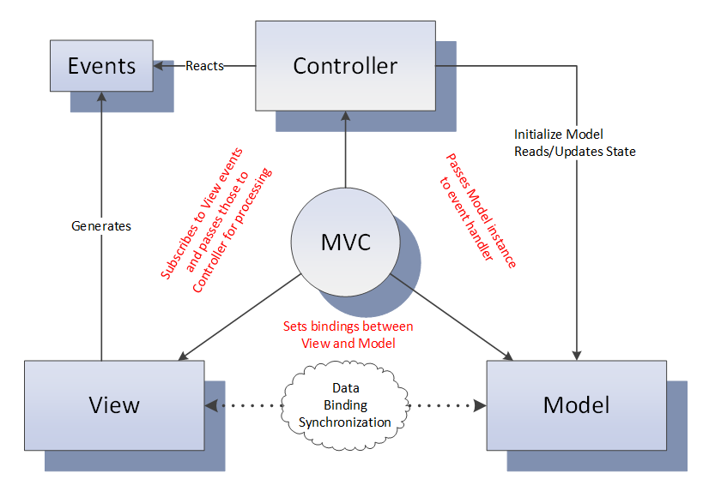
MVC – gluing pieces together
YOUR PRESENTATION LOGIC HERE

Slide 11
Data binding
type IView<'Events, 'Model> =
inherit IObservable<'Events>
abstract SetBindings : 'Model -> unit
<@ textBox.Text <- model.Name @>
textBox.SetBinding(TextBox.TextProperty, "Name")
Making implicit dependency explicit
Leveraging F#/.NET type system
Leveraging IDE/compiler
Optional module

Slide 12
Validation
Optional module
Statically-typed
Would be verbose without F# language features:
Active patterns
Explicit member constraints
Partial application

Slide 13
Async
“Async in C# and F#: Asynchronous gotchas in C#” blog post by Tomas Petricek
type IController<'Event, 'Model> =
abstract InitModel : 'Model -> unit
abstract EventHandler : ('Event -> 'Model -> unit)
type EventHandler = Model -> unit
type IController<'Event, 'Model> =
abstract InitModel : 'Model -> unit
abstract EventHandler : ('Events -> EventHandler<'Model>)
type EventHandler<'Model> =
| Sync of ('Model -> unit)
| Async of ('Model -> Async<unit>)
type IController<'Events, 'Model> =
abstract InitModel : 'Model -> unit
abstract Dispatcher : ('Events -> EventHandler<'Model>)

Slide 14
Child Windows
Dialog – synchronous computation
Non-modal window - asynchronous

Slide 15
Reentrancy
Very tricky problem

Slide 16

composition

Slide 17
External event sources
As easy as composing views
Rx.NET helps to ensure invocation on GUI thread
Another composition option

Slide 18
Data binding micro dsl
Scrap your boilerplate
F# gives great tools to build internal DSLs

Slide 19
Derived properties
Scrap your boilerplate
F# pure magic
ReflectedDefinitionAttribute
Quotation
Active patterns (a lot)
WPF black magic
Custom dynamic dependency properties
MultiBinding

Slide 20
F# 3.0/.net4.5
Queries
Type providers
WSDL
XAML
INotifyDataErrorInfo
ExceptionDispatchInfo

Slide 21
F# MVC for WPF
No INPC boilerplate model
Abstract polymorphic view
Loosely couple controller
Type checked event to handler mapping
Statically typed data-binding DSL
Lightweight validation
Type system supported Async
Dialogs/Windows as sync/async workflows
Reentrancy problem solved at one place
COMPOSITION
External event source
Declarative derived properties
Queries, type providers …
All components replaceable/optional except IView, IController and MVC

Slide 22
In summary
F# great general purpose language
Hard things easy impossible things possible
Go thru the framework code base – it’s great language tutorial

